Slide 1
How to Measure Well-being?
BMS-PHT // M-Psy
Co-Creative Development of An Experience Sampling Instrument of Minority Stress in Queer People Commentary for This presentation can be found in the speaker notes!
Notes:
Dear reader of this presentation. Thank you for reading! My name is Jan Behrens, I go by she/they/he, I am a student for master health psychology at the UT, and a member of Th!nk with Pride. I am writing to you about measuring queer well-being, which is a very serious topic.

Slide 2
Importance
Understanding:
The GMSR
Measuring:
Our instrument
Significance
Notes:
To do that, first I want to highlight why it is SO important to understand and measure it. In order to understand, we will look at the Gender Minority Stress and Resilience model. Regarding the measurement, I will present the instrument we developed for this purpose. Lastly, I hope to make clear both the significance of the research, and the direction we need to go from here.

Slide 3
Queerness And mental illness
Notes:
Historically, queer people have been marginalised, mistreated and ignored by society.

Slide 4
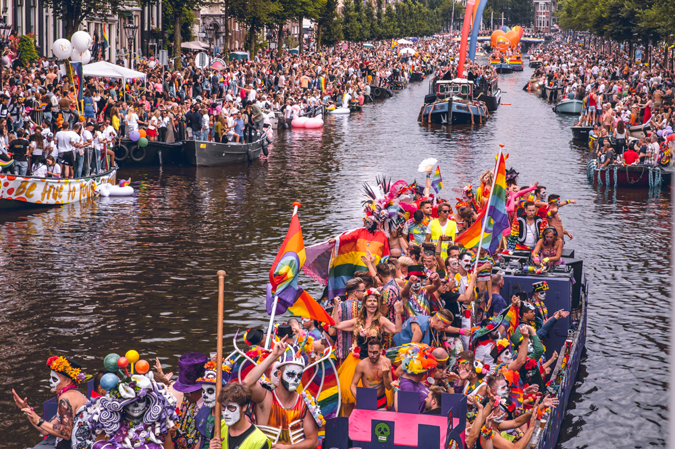
Queerness And mental illness
Notes:
Lately, queer pride has become more visible, but so have many negative sentiments towards queer people, our community, and our history.

Slide 5
Queerness And mental illness
Notes:
Connected to these sentiments, is an extraordinary health disparity between queer and cis-hetero people regarding mental well-being today.

Slide 6
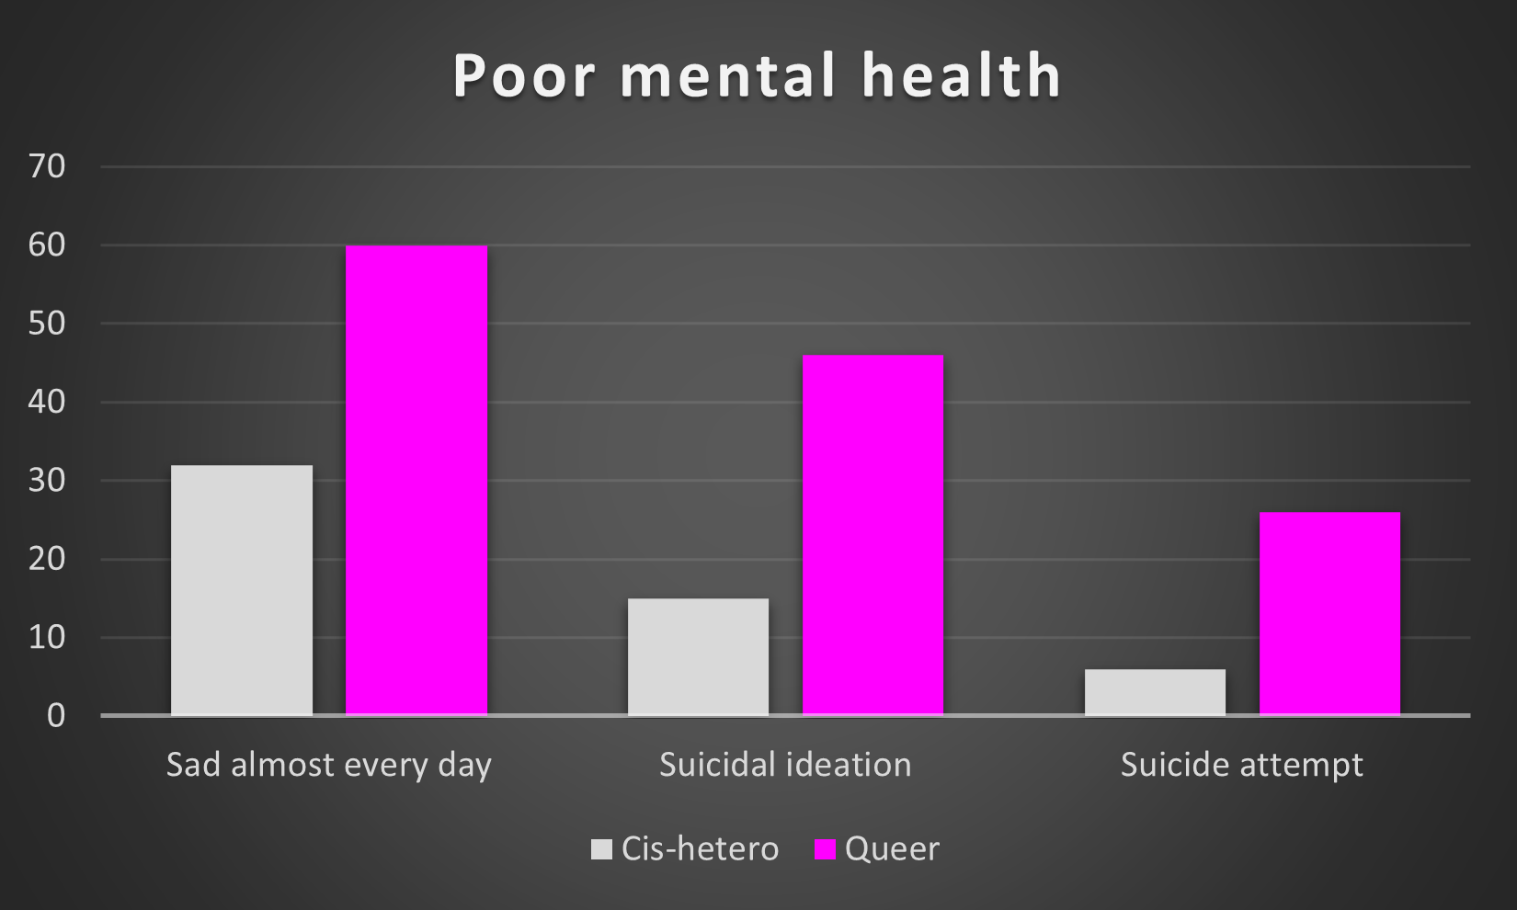
Queerness And mental illness
CDC. (2021). 2021 High School Youth Risk Behavior Survey Data. https://www.cdc.gov/healthyyouth/data/yrbs/results.htm
Notes:
This health disparity can be illustrated by some recent figures from the 2022 US High School Youth Risk Behavior Survey. No data from the Netherlands were available.
The data showed that 32% of cisgender, heterosexual youth felt sad or hopeless almost every day for at least 2 weeks vs. 53–66% of queer youth
In the last year, 15% of heterosexual cisgender youth seriously considered suicide, compared to 44–47% of queer youth.
Six percent of heterosexual, cisgender youth attempted suicide in the past year, compared to 23–29% of queer youth
We know, of course, that queerness is not mental illness or inherently connected to it. However, if queer people are not inherently mentally ill, how can we explain the very real health disparities they suffer?

Slide 7
Minority Stress
Stigma is a result of minority status
Minority status due to deviance from cis-hetero normality
Visibility as a minority can lead to being targeted & ‘other-ing’
Minority Stress Theory – Ilhan Meyer, 1998
Gender Minority Stress & Resilience Theory – Rylan Testa, 2015
Notes:
For this we look to minority stress theory. This poses that queer people experience stigma as a result of their minority status. They have this minority status because they deviate from cis-hetero normative expectations regarding gender. Queer expression is beautiful, vast, and, nowadays, thankfully, often very visible. This visibility also makes it easier to target us.
Therefore, minority stress is the idea that, if the world you live in is persistent in telling you that there is something wrong with you, that you do not fit in, that you do not belong - that will influence your self-image and how you see the world.
The minority stress theory was originally developed by Ilan Meyer in '98.
In 2015, Rylan Testa and colleagues published an adaptation of the model for gender minorities. This resulted in the gender minority stress and resilience theory and accompanying measure.

Slide 8
Gender minority Stress and Resilience Theory
Testa, R. J., Habarth, J., Peta, J., Balsam, K., & Bockting, W. (2015). Development of the Gender Minority Stress and Resilience Measure. Psychology of Sexual Orientation and Gender Diversity, 2(1), 65–77. https://doi.org/10.1037/sgd0000081
Notes:
The model first describes distal stressor factors, which are objectively observable instances of enacted stigma. Violence, verbal harassment, inequal access to health care.

Slide 9
Gender minority Stress and Resilience Theory
Testa, R. J., Habarth, J., Peta, J., Balsam, K., & Bockting, W. (2015). Development of the Gender Minority Stress and Resilience Measure. Psychology of Sexual Orientation and Gender Diversity, 2(1), 65–77. https://doi.org/10.1037/sgd0000081
Notes:
Distal stressors lead to proximal stressors: internalised beliefs relating to the individuals minority identity. Hating yourself for being queer or hiding it from yourself and the world.

Slide 10
Gender minority Stress and Resilience Theory
Testa, R. J., Habarth, J., Peta, J., Balsam, K., & Bockting, W. (2015). Development of the Gender Minority Stress and Resilience Measure. Psychology of Sexual Orientation and Gender Diversity, 2(1), 65–77. https://doi.org/10.1037/sgd0000081
Notes:
Both distal and proximal stressors negatively affect mental health.

Slide 11
Gender minority Stress and Resilience Theory
Testa, R. J., Habarth, J., Peta, J., Balsam, K., & Bockting, W. (2015). Development of the Gender Minority Stress and Resilience Measure. Psychology of Sexual Orientation and Gender Diversity, 2(1), 65–77. https://doi.org/10.1037/sgd0000081
Notes:
These relationships are moderated by resilience factors, which function as coping and social support and highlight stress-ameliorating factors.
These resilience factors are actually very important because they highlight the importance of queer joy. Being decisively proud to be queer and being connected with other queer people is special and should be celebrated.

Slide 12
GMSR Theory
Important theory to understand health disparity
Limitation: Cross-sectional research does not allow for causal inferences
Notes:
This model has been substantial in explaining the health disparities between cis-hetero and queer people. However, research using this model has been almost exclusively cross-sectional in nature, meaning no causal inferences about these processes can be drawn. Cross-sectional research is a snapshot of different constructs, present to different degrees, at the same time. Its like taking a picture. We make inferences about these processes by comparing different people and identifying where patterns are likely to occur and under which conditions. However, we can’t draw conclusions about what causes what.

Slide 13
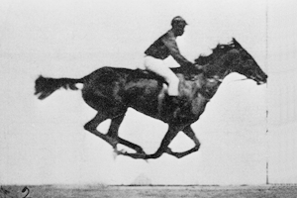
Thesis research project
Methodology: Experience Sampling
Within-individual covariation
Transient (momentary) phenomena
Repeated measures → causal inferences
Instrument background
GMSR measure
ES studies on LGBTQ+ minority stress
Validation by queer advisory group
Koopman, J., & Dimotakis, N. (2022). Experience Sampling Methodology. In Oxford Research Encyclopedia of Business and Management. Oxford University Press. https://doi.org/10.1093/acrefore/9780190224851.013.304
Notes:
To address these limitations, we developed a measure based on experience sampling. This is a method aimed primarily at examining within-individual covariation of transient phenomena by utilizing repeated measures. Through repeated assessments, we can make causal inferences. What this means is that we are looking at individual people and how psychological constructs that dont exist for very long (like affect states (being sad)) change together throughout daily life. Essentially, we are taking many pictures and connecting them, showing a movie. This is how we can make statements about X actually CAUSING Y, rather than just stating that if X is present, Y is also likely (like cross sectional research)
My thesis research thus aims to examine the constructs laid out by the GMSR model and confirm causal relationships between them.
All questions were developed based on the items of the GMSR measure and previous ES studies into minority stress. Subsequently, they were face-validated with a queer advisory group. To immerse you in the participant experience, I will discuss the items in the order they appear in the survey.

Slide 14
Distal Stressors (Events)
Notes:
In the survey, the first part assesses distal stressors. Participants indicate which, if any, of the negative events they have encountered since the last survey. For some audience engagement, I would like to invite you to read the following statements and consider whether you have ever encountered something like it.

Slide 15
Discrimination
I had difficulties finding and/or could not find an all-gender bathroom.
I felt dysphoric, judged, and/or unsafe in a public bathroom

Slide 16
Rejection
I was rejected, excluded, and/or made to feel unwelcome
I was treated unfairly, differently, and/or disrespectfully
I was stared or looked at judgementally
I was ignored, isolated, made to feel invisible, and/or not taken seriously
I was criticised for my appearance and/or made to change it

Slide 17
Victimisation
I heard a queerphobic slur, stereotype, and/or statement
I was pushed, hit, targeted when someone threw something, and/or otherwise physically harmed
I was made to feel unsafe and/or acted uncomfortably around
I was sexually harassed or assaulted
I was verbally harassed, made fun of, and/or threatened

Slide 18
Non-affirmation
I was misgendered, deadnamed, and/or addressed with the wrong pronouns

Slide 19
Community Connectedness (Events)
Notes:
The next step for participants relates to events of community connectedness. Again, participants indicate which, if any, of the positive events they have encountered since the last survey

Slide 20
Community Connectedness
I have spent time interacting with queer people
I felt connected to, and as a part of the queer community
I saw and/or felt seen by queer people
I saw queer representation
I was accepted, affirmed, and/or embraced by queer people.

Slide 21
Proximal Stressors Visual analogue Scale
Notes:
Next, proximal stressors are assessed. For these, participants rate their agreement with statements on a visual-analogue scales, from 0 - fully disagree, to 100 - fully agree.

Slide 22
Proximal Stressors
Internalised Transphobia
Being queer makes me feel depressed, unhappy, embarrassed, or ashamed.
Negative Expectations
Openly expressing my queerness will lead to negative events in the future.
Identity Concealment
I hide, mask, or repress my queer identity/expression

Slide 23
Pride Visual analogue Scale
Notes:
Pride is assessed next, using the same answer modality to reduce participant burden.

Slide 24
Pride
Being queer makes me feel proud, happy, special, and unique
I am comfortable being open about my queer identity/expression

Slide 25
Mental Health & Well-being visual analogue scale
Notes:
Finally, mental health outcomes are assessed. Here, participants rate their experience of feelings on a visual-analogue scale, from 0 - not at all, to 100 - extremely.

Slide 26
Mental Health & Well-being
PHQ-4
Depression
Feeling down, depressed or hopeless
Little interest or pleasure in doing things
Anxiety
Feeling nervous, anxious or on edge
Not being able to stop or control worrying
MHC-SF
Well-being
Emotional - Satisfied with life
Psychological - Confident to think or express your own ideas and opinions
Social - That our society is becoming a better place for people

Slide 27
Significance of Research
Expected outcome – proof for queer minority stress & resilience
Health Psychology suggests we develop interventions!
1st Approach: Advocacy for DE&I
2nd Approach: Community & Pride
Notes:
So, what is the significance of this research? We expect to have some proof for a model of queer minority stress and resilience, where do we go from here? As a health psychologist, I see two approaches.
As with most psychological interventions, if we know the antecedents of a problem, we can attempt to target and change them to achieve a more desirable quality of life.
The first intervention we can make is in decreasing distal stressors. By challenging anti-queer stigma, we can reduce the discrimination, rejection, victimisation, and non-affirmation experienced by queer people. To achieve this, we as a society must strive for diversity, equity, and inclusion. Everyone needs to speak out for this. You are informed about this now. If you're silent, you're complicit.
The second intervention is connecting queer people, celebrating queer joy, and supporting each other. Being visible as a connected queer community is crucial for our ability to benefit from this social resource. Keep being proud, keep being out, keep being loud. Everyone should be able to be their most authentic self and we have to make sure everyone knows.

Slide 28
Take-home messages
Queerphobia is still alive, speak out against it.
Queer joy is everywhere, make sure to seek and celebrate it.
Notes:
Thank you for reading my words today. This research is very important to me as a queer person interested in queer well-being. If there are two statements that I would like you to internalise today, they are these:
Queerphobia is still alive (unfortunately), speak out against it.
Queer joy is everywhere, make sure to seek and celebrate it.
Thank you

