Slide 1
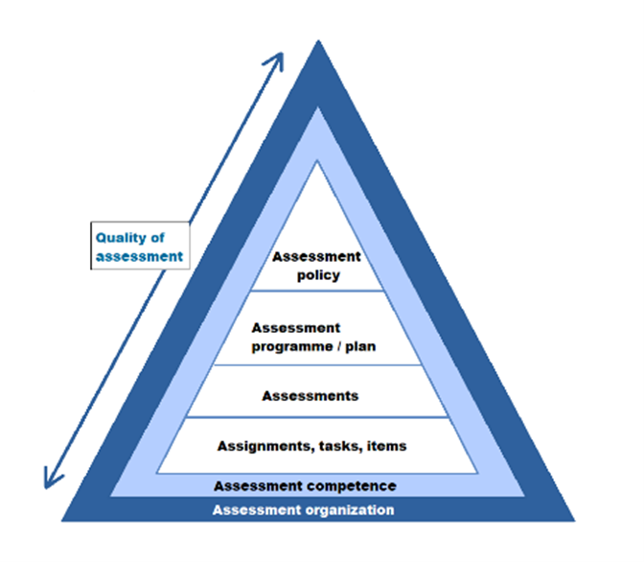
Improving the assessment policy of the MEEM programme
Summary
Effective assessment policy: Use of assessment for different purposes; clear responsibilities of stakeholders, and the assessment procedures and guidelines; directions to assure the assessment quality.
MEEM assessment policy: Several components exist, but not communicated clearly and implemented regularly. Confusion and ambiguity about the vision, principles, roles and procedures.
Recommendations: Actions to improve the assessment policy of MEEM. Participation of all stakeholders and the integration of the policy into existing quality assurance cycles.
Recommendations
Create a vision on assessment
Clarify the responsibilities of stakeholders
Diversify the tools and support for quality assurance process
Enhance assessment-related communication with students and teachers
Why?
Several elements of an assessment policy spread over different processes and documents:.
Recent changes: Revised PILOs and assessment plan; courses (re)designed or taken over by new teachers.
Risks: Ambiguity about the scope and purpose of assessments across courses and quartiles; students not achieving the PILOs; teachers not demonstrating assessment competences.
Diversity and plurality of assessment methods, while preventing over-fragmentation.
Guidance to teachers about their role within the assessment organisation
How?
Accreditation: Preparation process to implement the actions and write the policy document. Six-year cycle for comprehensive evaluation.
PDCA cycle: Time-bound actions assigned to team members. Annual cycle to evaluate the policy and receive feedback from stakeholders.
Ownership and participation of stakeholders: teachers (to adopt the policy), and the PMT (to implement and monitor the policy).
Acknowledgements
I would like to thank MEEM teachers and programme coordinators and the SUEQ advisors and trainees for their input, feedback and support.
Dr. Gül Özerol, Associate Professor & MEEM Programme Director, SUEQ Trainee, 2023.
CSTM – Section of Governance and Technology for Sustainability, Faculty of BMS

